Slide 1
Chapter 20
When and how to use third-party development tools

Slide 2
Objectives
Applied
If you’re using Brackets as your text editor and you have installed Emmet, use Emmet to enter abbreviations, expand abbreviations, and move from one item to the next.
Knowledge
In general terms, describe these third-party development tools and the reasons why professional developers use them:
Emmet GitHub Sass Bootstrap Node Package Manager Gulp.js

Slide 3
Objectives (continued)
Describe the use of Emmet for entering an abbreviation, expanding it, and moving from one item to the next.
Describe the use of Sass nesting, variables, and mixins.
Describe the use of the Bootstrap grid system.
Describe the use of Bootstrap components.

Slide 4
Some of the most useful third-party tools
Emmet
Git and GitHub
Sass
Bootstrap
Node.js
Gulp.js

Slide 5
Some of the reasons for using third-party tools
Increase the efficiency of writing HTML code
Develop style sheets that are easier to maintain
Automate repetitive and time-consuming tasks
Reduce the need for JavaScript and jQuery plugins
Make projects easier to manage
Simplify the management of some third-party tools

Slide 6
Common Emmet actions
Expand an abbreviation
Select the next opening tag, attribute, or attribute value
Wrap selected HTML in another element
Remove an element but not the element’s content

Slide 7
An Emmet abbreviation for a navigation menu
nav>ul>li*5>a[href="target.html"]#item${Link Text}
The HTML generated from the Emmet abbreviation
<nav>
<ul>
<li><a href="target.html"
id="item1">Link Text</a></li>
<li><a href="target.html"
id="item2">Link Text</a></li>
<li><a href="target.html"
id="item3">Link Text</a></li>
<li><a href="target.html"
id="item4">Link Text</a></li>
<li><a href="target.html"
id="item5">Link Text</a></li>
</ul>
</nav>

Slide 8
What GitHub is
A web-based hosting service for Git repositories, or repos
A Distributed Source Control system

Slide 9
Sass for nesting
nav {
ul {
list-style-type: none;
margin-left: 1.25em;
margin-bottom: 1.5em; }
li {
width: 200px;
margin-bottom: .5em;
border: 2px solid blue; }
a {
display: block;
padding: .5em, 0 .5em, 1/5em;
text-decoration: none;
color: blue; }
}

Slide 10
The CSS that’s compiled from the nested Sass
nav ul {
list-style-type: none;
margin-left: 1.25em;
margin-bottom: 1.5em; }
nav li {
width: 200px;
margin-bottom: .5em;
border: 2px solid blue; }
nav a {
display: block;
padding: .5em, 0 .5em, 1.5em;
text-decoration: none;
color: blue; }

Slide 11
A Sass script that uses variables
$font: Arial, Helvetica, sans-serif;
$color-1: white;
$color-2: navy;
body {
font-family: $font;
background-color: $color-1;
}
h1 { color: $color-2; }
The CSS that’s compiled from the Sass
body {
font-family: Arial, Helvetic, sans-serif;
background-color: white; }
h1 {
color: navy; }

Slide 12
A Sass script that uses a mixin
@mixin box($bgcolor) {
width: 100px;
height: 100px;
background-color: $bgcolor; }
.box1 { @include box(red); }
.box2 { @include box(blue); }
The CSS that’s compiled from the Sass
.box1 {
width: 100px;
height: 100px;
background-color: red; }
.box2 {
width: 100px;
height: 100px;
background-color: blue; }

Slide 13
The four main modules of Bootstrap
Layout
Content
Components
Utilities

Slide 14
A Bootstrap starter template
<!doctype html>
<html lang="en">
<head>
<meta charset="utf-8">
<meta name="viewport" content="width=device-width,
initial-scale=1, shrink-to-fit=no">
<link rel="stylesheet"
href="css/bootstrap.min.css">
<title>A basic Bootstrap starter template</title>
</head>
<body>
<!-- Web page content goes here -->
<script
src="https://code.jquery.com/jquery-3.2.1.min.js">
</script>
<script src="js/popper.min.js"></script>
<script src="js/bootstrap.min.js"></script>
</body>
</html>

Slide 15
A fixed-width layout that uses Bootstrap grid
<div class="container">
<div class="row">
<div class="col-4">Column 1</div>
<div class="col-6">Column 2</div>
<div class="col-2">Column 3</div>
</div>
</div>

Slide 16
A fluid layout with equally-sized columns
<div class="container-fluid">
<div class="row">
<div class="col-4">Column 1</div>
<div class="col-6">Column 2</div>
<div class="col-2">Column 3</div>
</div>
</div>

Slide 17
A responsive Bootstrap layout with different column widths at different screen sizes
<div class="container-fluid">
<div class="row">
<div class="col-md-3 col-sm-6">Column 1</div>
<div class="col-md-3 col-sm-6">Column 2</div>
<div class="col-md-6 col-sm-12">Column 3</div>
</div>
</div>

Slide 18
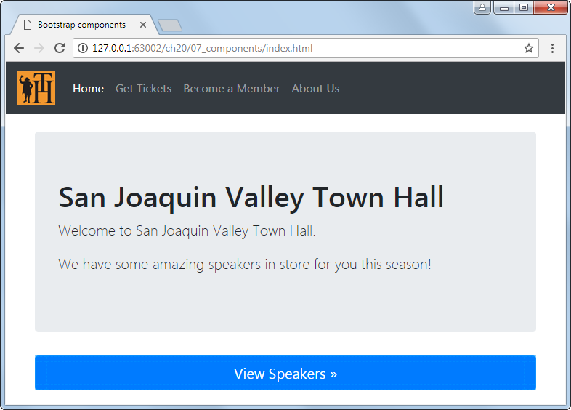
A page that uses Bootstrap components

Slide 19
The HTML for the components
<nav class="navbar navbar-expand-md navbar-dark bg-dark mb-4">
<a class="navbar-brand" href="#">
<img src="images/logo.gif" alt="Logo"></a>
<button class="navbar-toggler" type="button"
data-toggle="collapse"
data-target="#navbarCollapse"
aria-controls="collapsibleNavbar"
aria-expanded="false"
aria-label="Toggle navigation">
<span class="navbar-toggler-icon"></span>
</button>

Slide 20
The HTML for the components (continued)
<div class="collapse navbar-collapse"
id="collapsibleNavbar">
<ul class="navbar-nav mr-auto">
<li class="nav-item active">
<a class="nav-link" href="#">Home
<span class="sr-only">(current)</span></a>
</li>
...
<li class="nav-item">
<a class="nav-link" href="#">About Us</a>
</li>
</ul>
</div>
</nav>

Slide 21
The HTML (continued)
<main role="main" class="container">
<div class="jumbotron">
<h1>San Joaquin Valley Town Hall</h1>
<p class="lead">Welcome to San Joaquin Valley Town
Hall.</p>
<p class="lead">We have some amazing speakers
...</p>
</div>
<a class="btn btn-lg btn-primary btn-block"
href="#" role="button">View Speakers &raquo;</a>
</main>

Slide 22
The main components of Node.js
Node CLI
NPM
Node Modules

Slide 23
How to install Gulp and add it to a project
Open a command prompt and enter:
npm install gulp-cli -g
Verify that a package.json file exists in your project. If not, use NPM to create it.
Switch to your project directory by entering:
cd projectname
To install the Gulp.js module dependency and add a dependency reference to your package.json file, enter:
npm install gulp --save-dev

Slide 24
How to install the Gulp plugins for compiling Sass and minifying
At the command prompt for your project directory, enter these commands:
npm install gulp-sass --save-dev
npm install gulp-clean-css --save-dev

Slide 25
A Gulp script with Sass compile and watch tasks
var gulp = require("gulp"),
sass = require("gulp-sass"),
cleancss = require("gulp-clean-css");
gulp.task("sass", function() {
return gulp.src("scss/*.scss")
.pipe(sass())
.pipe(cleancss())
.pipe(gulp.dest("css"));
});
gulp.task("watch", function() {
gulp.watch("scss/*.scss", ["sass"]);
})
Commands at the Node.js command prompt that execute the tasks
gulp sass
gulp watch

